Slide 1
Mammals
Env Sci Fall 2014/15

Slide 2
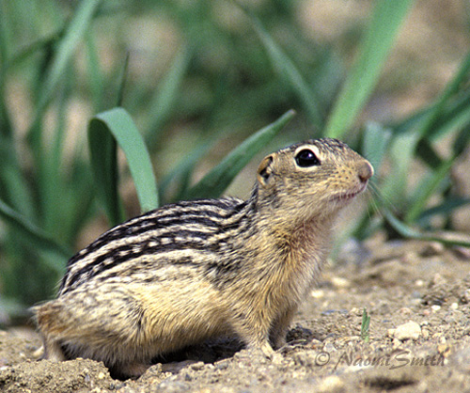
Notes:
13 Lined Ground Squirrel

Slide 3
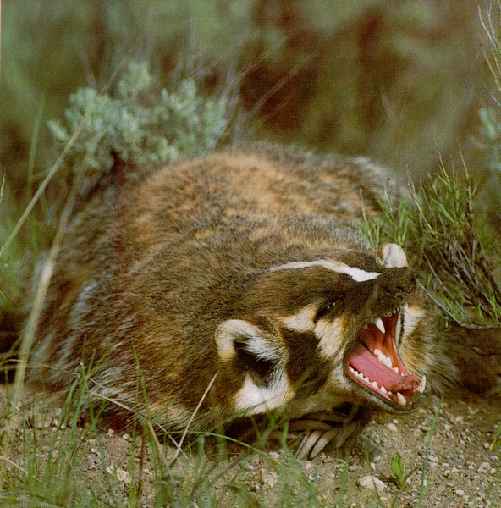
Notes:
Badger

Slide 4
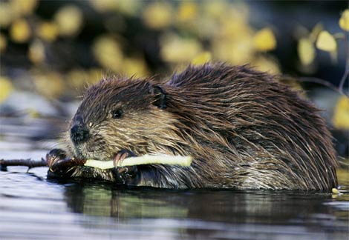
Notes:
Beaver

Slide 5
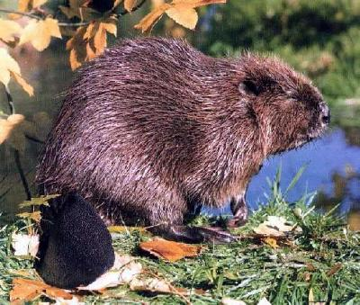
Notes:
Beaver

Slide 6
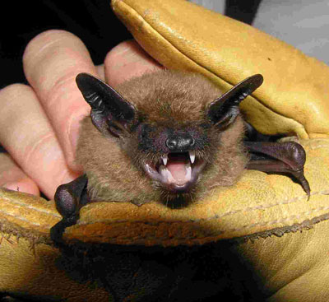
Notes:
Big Brown Bat

Slide 7
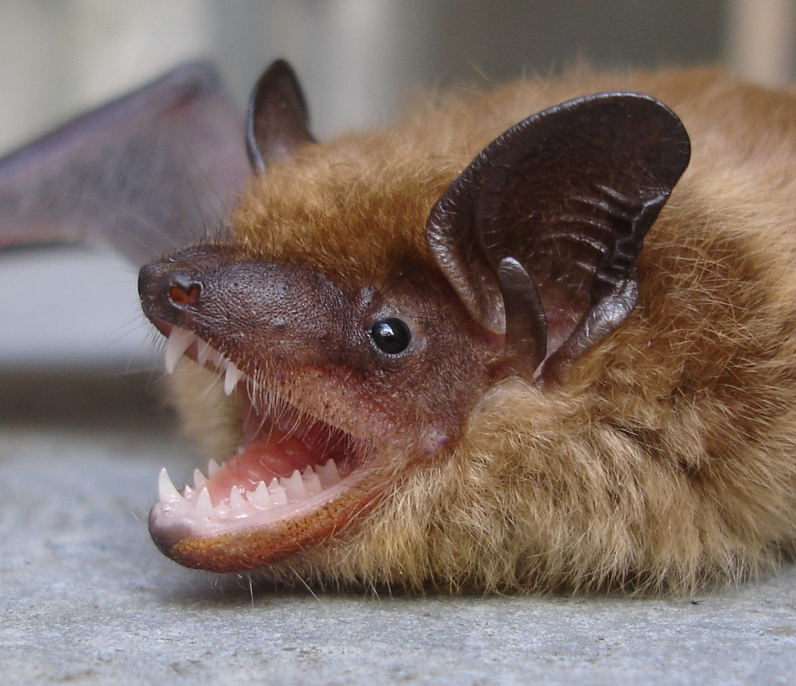
Notes:
Northern Bat

Slide 8
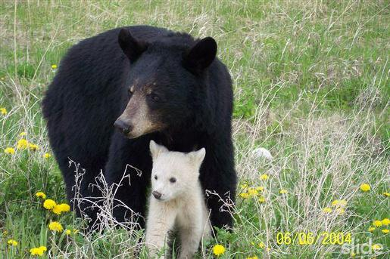
Notes:
Black Bear

Slide 9
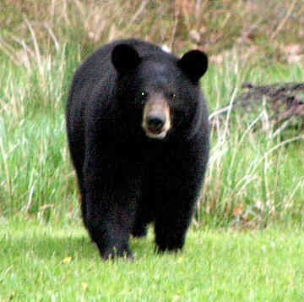
Notes:
Black Bear

Slide 10
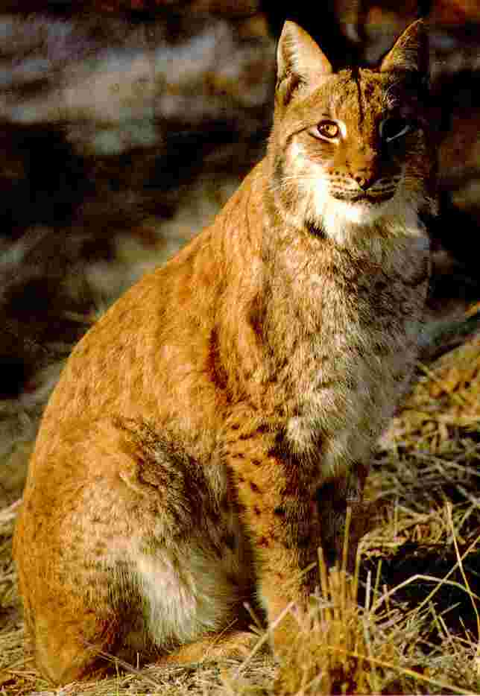
Notes:
Bobcat

Slide 11
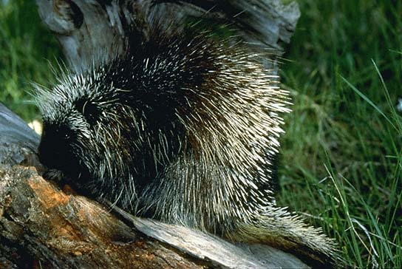
Notes:
Porcupine

Slide 12
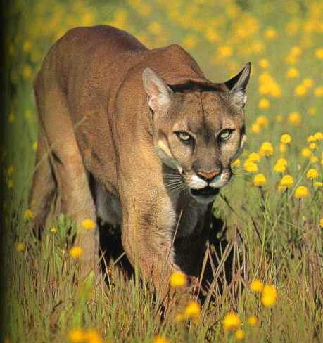
Notes:
Cougar

Slide 13
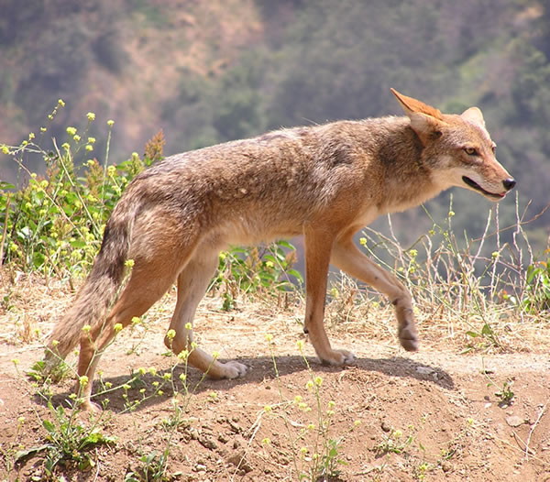
Notes:
Coyote

Slide 14
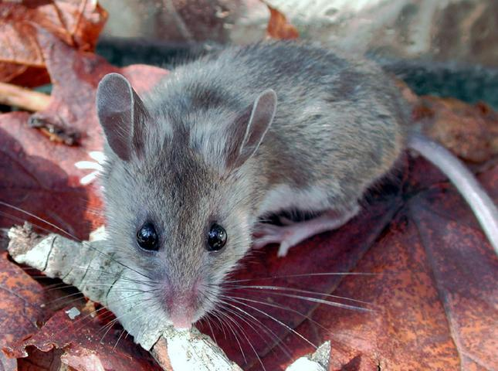
Notes:
Deer Mouse

Slide 15
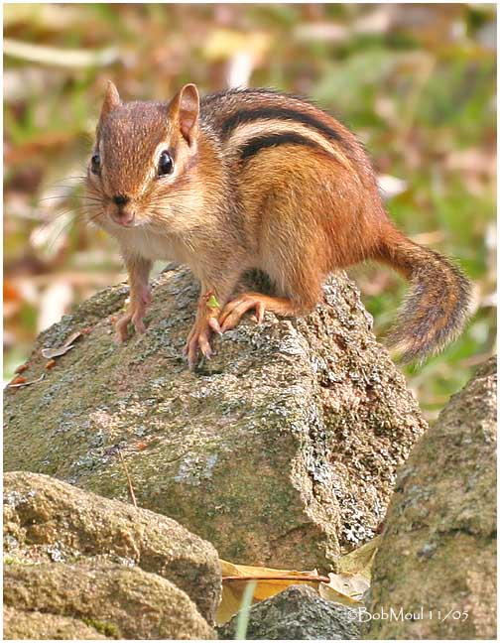
Notes:
Eastern Chipmunk

Slide 16
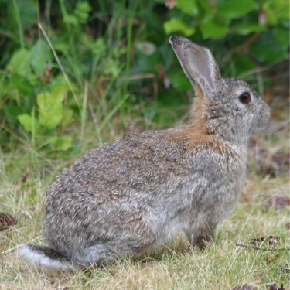
Notes:
Cottontail

Slide 17
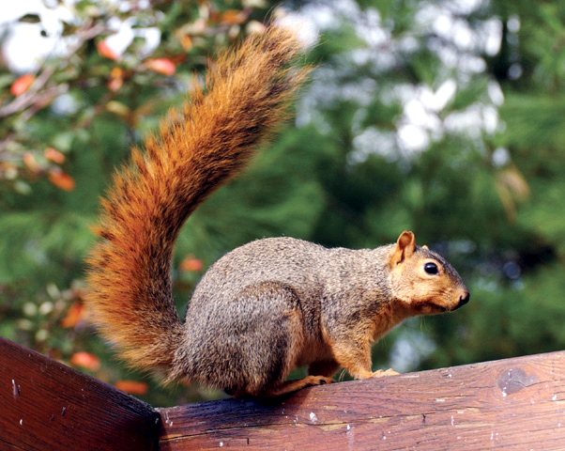
Notes:
Red Squirrel

Slide 18
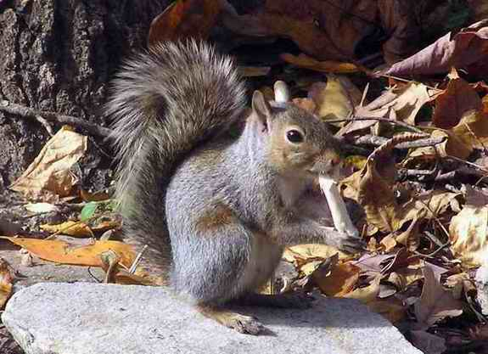
Notes:
Gray Squirrel

Slide 19
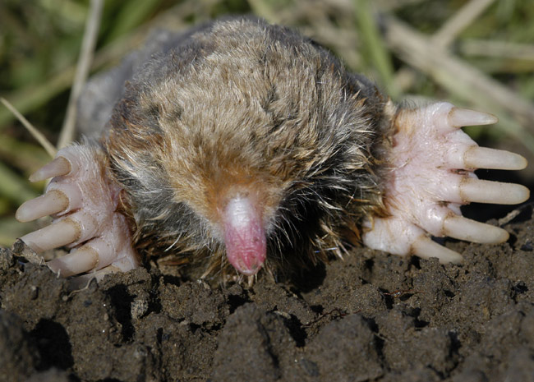
Notes:
Eastern Mole

Slide 20
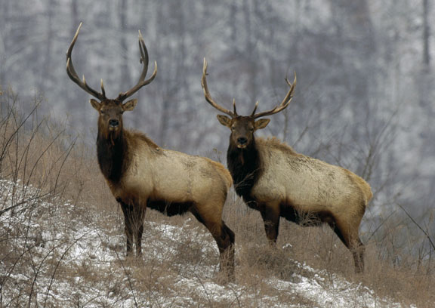
Notes:
Elk

Slide 21
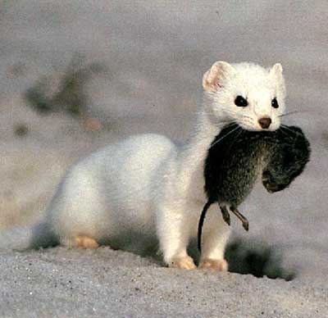
Notes:
Ermine

Slide 22
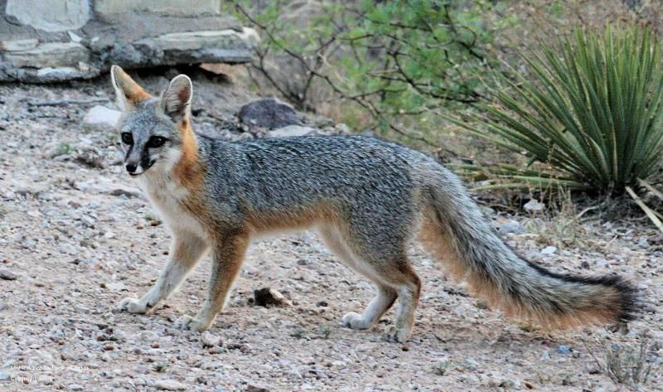
Notes:
Grey Fox

Slide 23
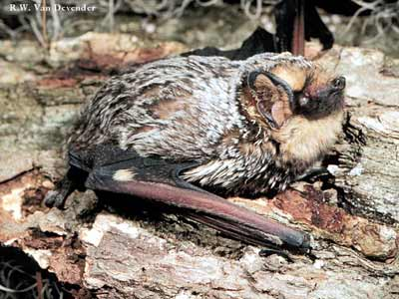
Notes:
Hoary Bat

Slide 24
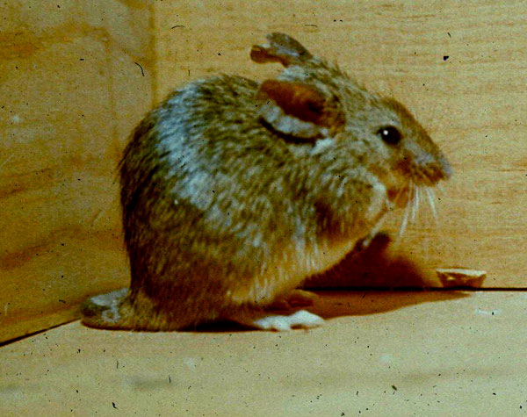
Notes:
House Mouse

Slide 25
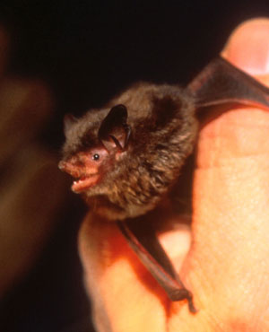
Notes:
Indiana Bat

Slide 26
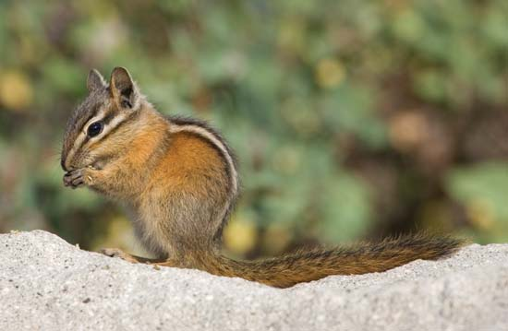
Notes:
Least Chipmunk

Slide 27
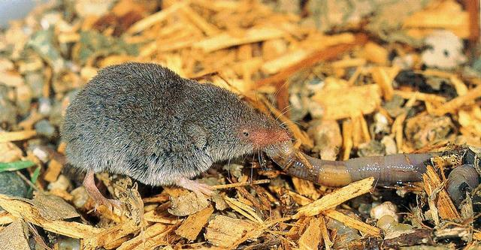
Notes:
Least Shrew

Slide 28
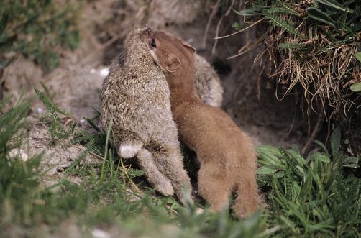
Notes:
Least Weasel

Slide 29
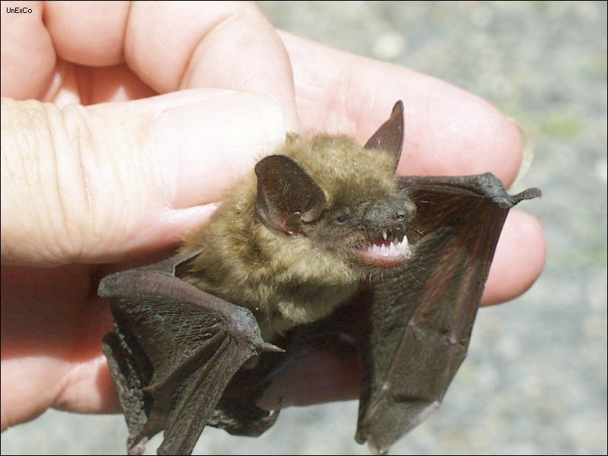
Notes:
Little Brown Bat

Slide 30
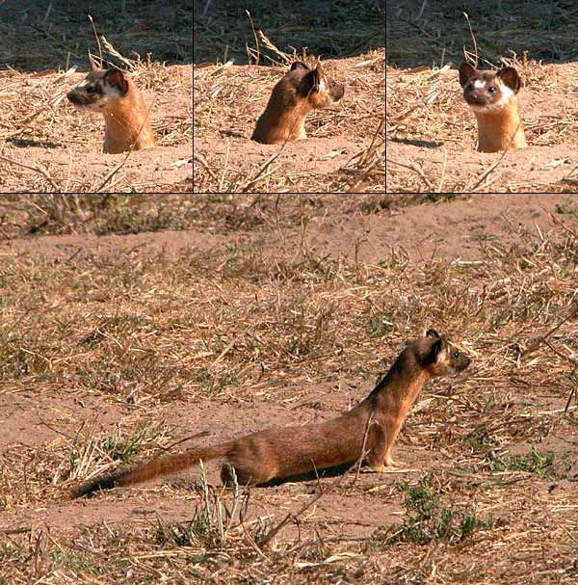
Notes:
Long Tailed Weasel

Slide 31
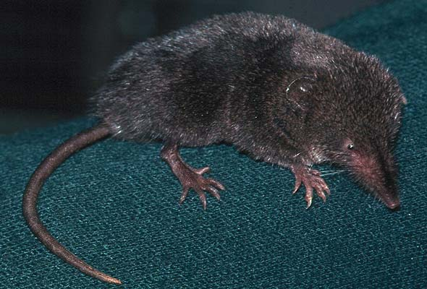
Notes:
Long Tailed Shrew

Slide 32
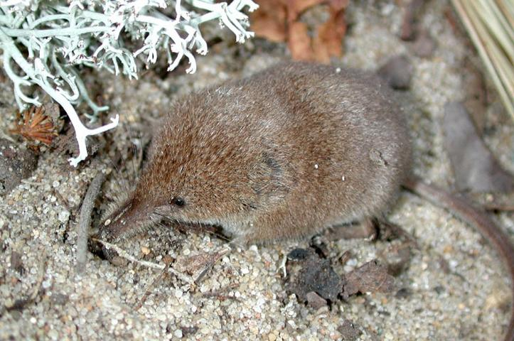
Notes:
Pygmy Shrew

Slide 33
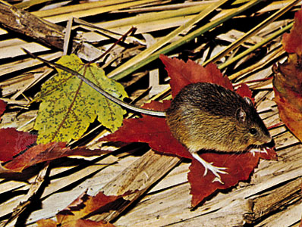
Notes:
Meadow Jumping Mouse

Slide 34
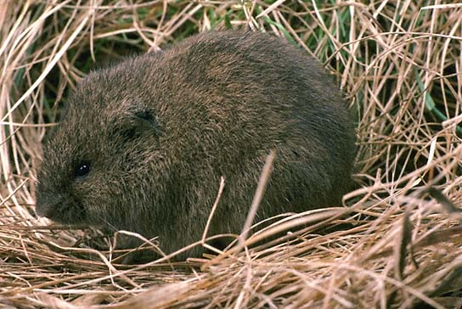
Notes:
Meadow Vole

Slide 35
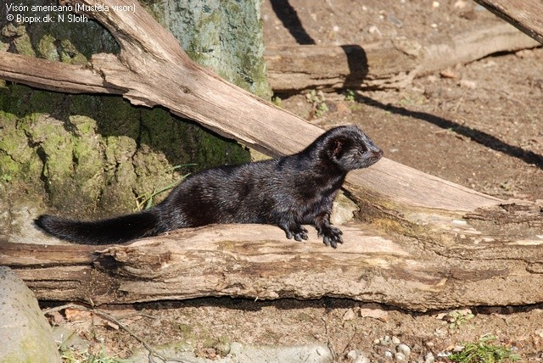
Notes:
Mink

Slide 36
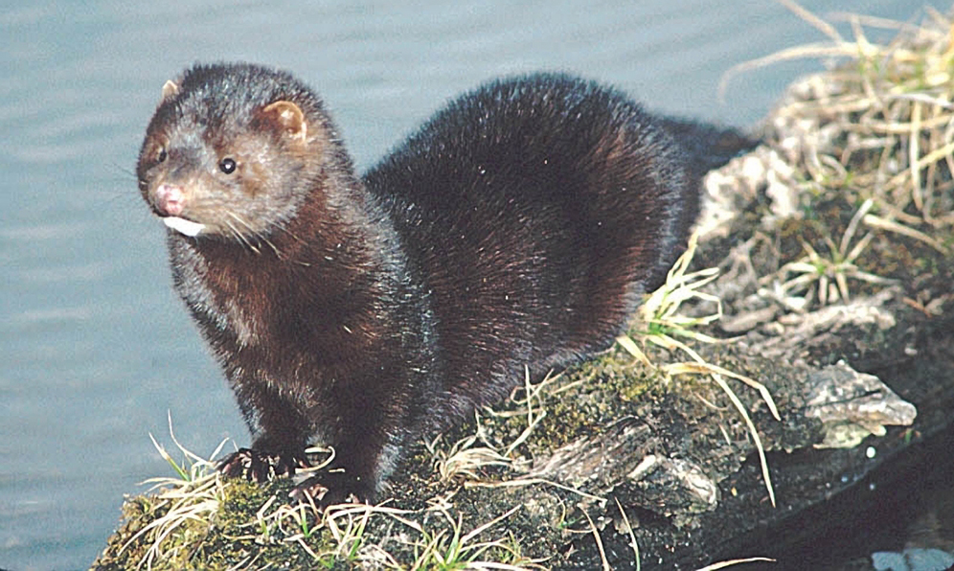
Notes:
Mink

Slide 37
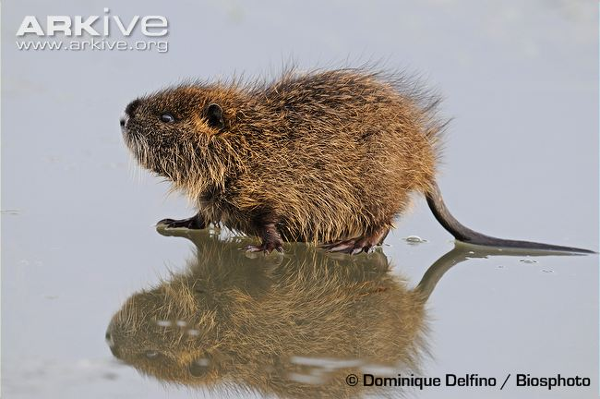
Notes:
Muskrat

Slide 38
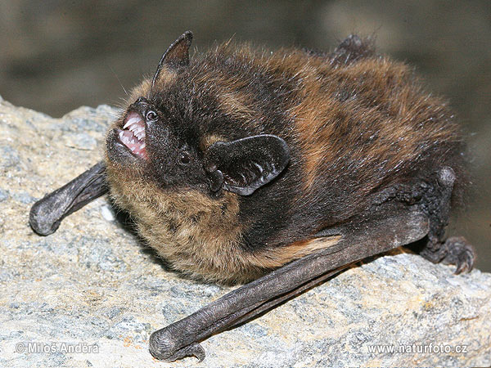
Notes:
Northern Bat

Slide 39
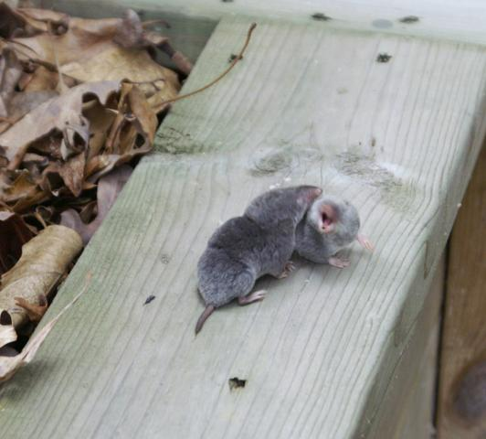
Notes:
Short tailed shrew

Slide 40
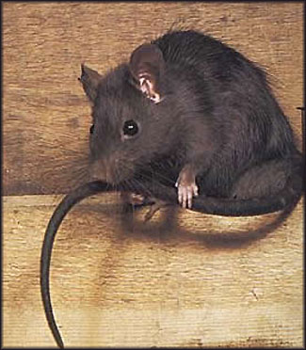
Notes:
Norway Rat

Slide 41
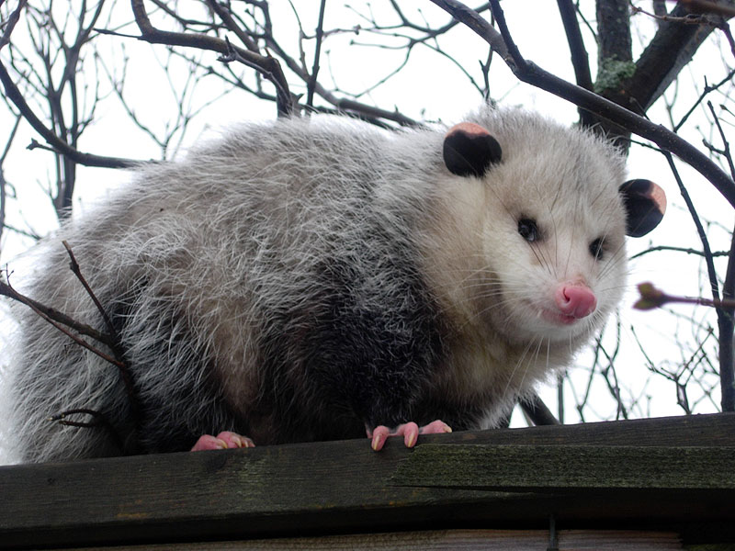
Notes:
Oppossum

Slide 42
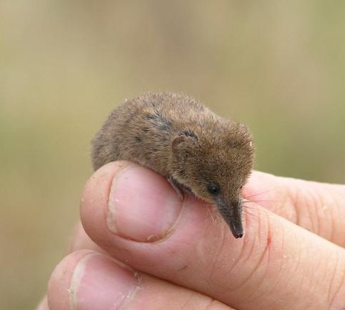
Notes:
Pygmy Shrew

Slide 43
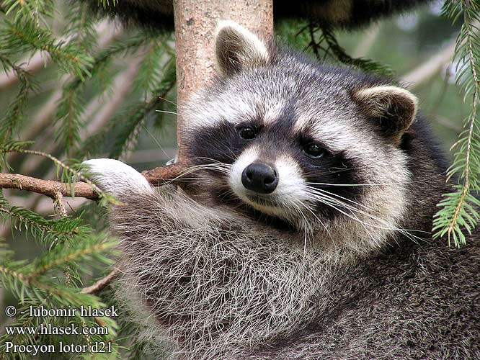
Notes:
Raccoon

Slide 44
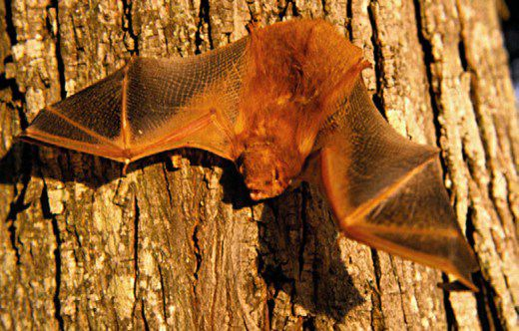
Notes:
Red Bat

Slide 45
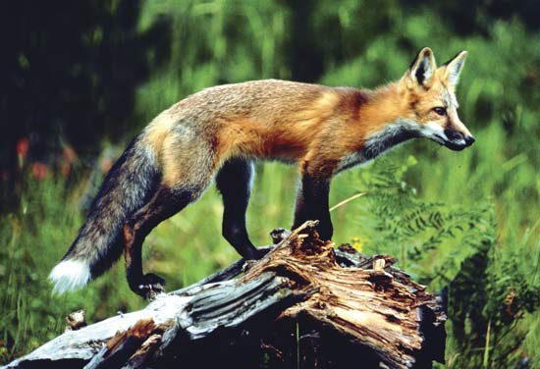
Notes:
Red Fox

Slide 46
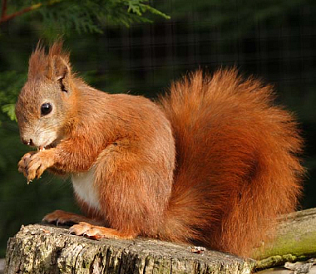
Notes:
Red Squirrel

Slide 47
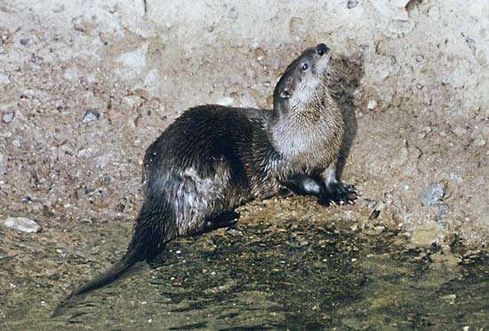
Notes:
River Otter

Slide 48
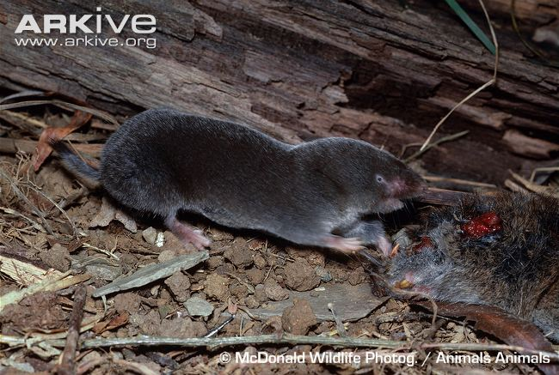
Notes:
Short Tailed shrew

Slide 49
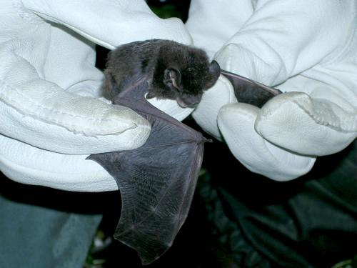
Notes:
Silver Bat

Slide 50
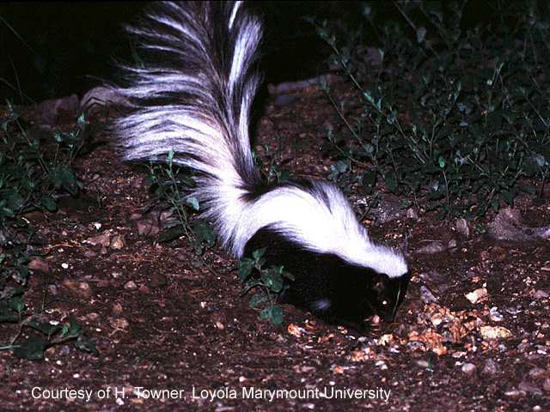
Notes:
Skunk

Slide 51
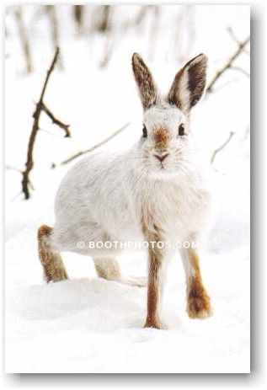
Notes:
Snow Shoe Hare

Slide 52
Notes:
Bog Lemming

Slide 53
Notes:
Southern Flying Squirrel

Slide 54
Notes:
Star Nosed Mole

Slide 55
Notes:
Water Shrew

Slide 56
Notes:
White Footed Mouse

Slide 57
Notes:
White Tailed Deer

Slide 58
Notes:
Wolverine

Slide 59
Notes:
Woodchuck

Slide 60
Notes:
Woodland Vole

